Slide 1
Unit 5 :
Making inquiries
Session 3
Databases

Slide 2
Table combination
External meetings.
LEFT JOIN
RIGHT JOIN

Slide 3
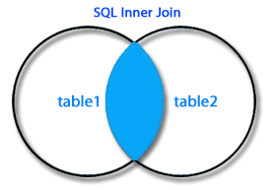
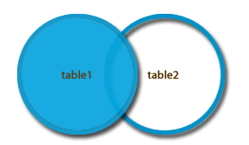
External meeting on the left. LEFT JOIN
Allows you to match rows from two tables through a relationship between a column in one table and another column in another table. So far everything is the same as INNER JOIN.
It also adds combinations of rows from the left table with empty columns from the right table or to null values for those rows from the left table that do not correspond to rows from the right table.
For example, if you make a AUTOMOVILES LEFT JOIN CONTRATOS ON automoviles.matricula = Contratos.matricula
For cars that have never been contracted, a row would be generated with the car data and all contract data set to NULL.
Syntax :
The same as for INNER JOIN. ON and USING clauses can be used .
SQL Left Join

Slide 4
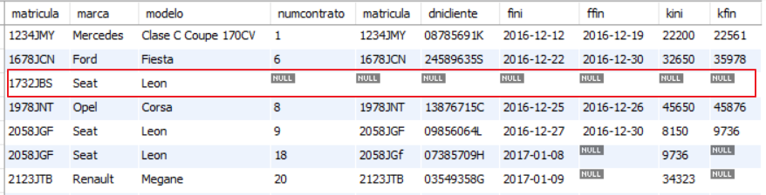
External meeting on the left. LEFT JOIN
Example: Obtain the license plate, make and model of all cars along with data on all contracts that have been made on those cars. For cars never contracted you should also get a row that is not related to any contract.
SELECT automobiles.registration, make, model, contracts .* FROM automobiles LEFT JOIN contracts USING (registration);

Slide 5
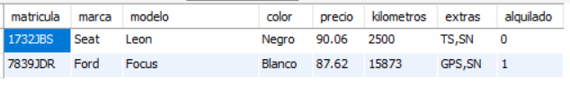
External meeting on the left. LEFT JOIN
Example: Obtain the data of all the cars that have never been contracted.
SELECT automobiles.* FROM automobiles LEFT JOIN contracts USING (registration) WHERE contractnum IS NULL;

Slide 6
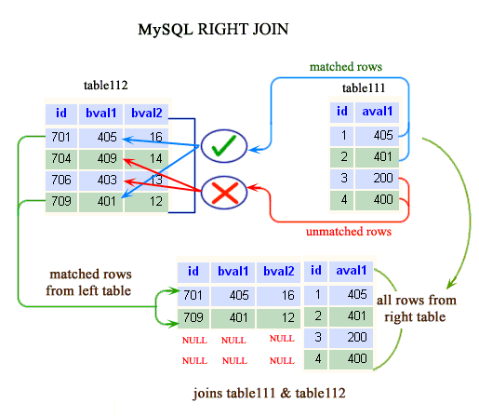
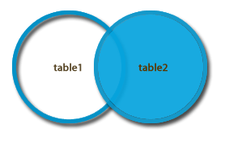
External meeting on the right. RIGHT JOIN
Allows you to match rows from two tables through a relationship between a column in one table and another column in another table. So far everything is the same as INNER JOIN.
It also adds combinations of rows from the right table with empty columns from the left table or to null values for those rows from the right table that do not correspond to rows from the left table.

Slide 7
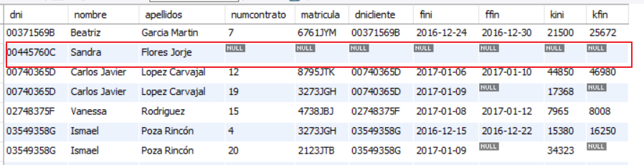
External meeting on the right. RIGHT JOIN
Example: Obtain the ID, name and surname of all registered clients along with the data of the contracts they have made. The results sheet must also show clients who have not made any contracts.
SELECT clients.dni,firstname,lastname,contracts .* FROM contracts RIGHT JOIN clients ON dni = dnicliente ;

Slide 8
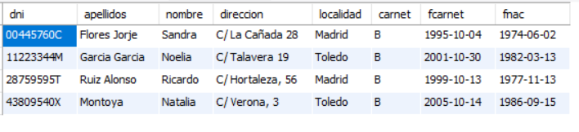
External meeting on the left. RIGHT JOIN
Example: Obtain the data of all clients who have never made contracts.
SELECT clients.* FROM contracts RIGHT JOIN clients ON dni = dnicliente WHERE contractnum IS NULL;

Slide 9
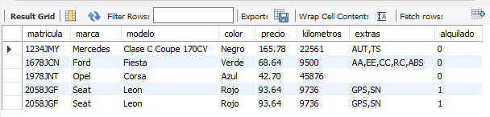
Other types of meetings
NATURAL JOIN
Allows you to combine rows from two tables related by equality between two fields. The conditions are:
tables have one or more pairs of columns with identical names.
The columns must be of the same data type.
The ON clause is not used.
Example : Obtain the data of the cars that have made the first five contracts.
SELECT cars.* FROM cars NATURAL JOIN contracts LIMIT 5;
STRAIGHT JOIN
It can be used with the ON and USING clauses to do the same as INNER JOIN. Without these clauses it does the same as NATURAL JOIN.

